Slide 1
UNLOCK YOUR GOOGLEADS POTENTIAL
Physical Therapy - General
GEO-TARGETING: Harrisburg Pennsylvania

Slide 2
CPA $35-80
CLIENT GOALS
By pairing a landing page built to convert with highly relevant keywords and ad copy
HOW WE HELPED
Our PPC strategy has seen some fantastic results within key metrics.

Slide 3
IMPRESSIONS
457,624
CLICKS
3,788
QUICK
STATS
CONV RATE
6.94%
CONVERSIONS
263
-Additional Comments here-

Slide 4
$45.73
263
CPA
NO. OF CONVERSIONS
#3.18
6.94%
CPC
CONVERSION RATE
RESULT
100%
RESULTS
IMPRESSION SHARE
MOBILE % OF TOTAL CONV
4/10
100%
QUALITY SCORE
MOBILE FRIENDLY CLICK RATE
79.29%
0.83%
% TOP IMPR SHARE
CTR
-Additional Comments here-

Slide 5
CAMPAIGN REVIEW
By pairing landing page with keywords, focused on mobile and phone calls to increase new patient leads

Slide 6
x
GLOSSARY
CPA - CPA WILL GIVE YOU AN ESTIMATE OF HOW MUCH YOUR NEW CUSTOMERS ARE COSTING YOU AND HELP YOU DETERMINE WHETHER YOUR STRATEGY NEEDS TO BE REVISED. UNLIKE THE CONVERSION RATE, WHICH IS AN INDICATOR OF SUCCESS, COST PER ACQUISITION IS A FINANCIAL METRIC USED TO MEASURE THE REVENUE IMPACT OF A MARKETING CAMPAIGN.
CPC - CPC IS THE MOST IMPORTANT FACTOR THAT DECIDES THE EARNINGS OF THE PUBLISHERS. AS FAR AS WE HAVE ANALYZED CPC DEPENDS ON THREE SIMPLE FACTORS – COUNTRY, KEYWORDS AND QUALITY/AGE OF THE SITE.IMPRESSION SHARE -
IMPRESSION SHARE - IMPRESSION SHARE AS AN IMPORTANT METRIC THAT SHOWS ADVERTISERS HOW MUCH MORE THEY COULD DO WITH THEIR CURRENT AD CAMPAIGNS. MOST OF THE OTHER METRICS SHOW ADVERTISERS CURRENT STATS ON ONGOING CAMPAIGNS, RATHER THAN POTENTIAL OPPORTUNITIES.

Slide 7
QUALITY SCORE - QUALITY SCORE IS GOOGLE'S RATING OF THE QUALITY AND RELEVANCE OF BOTH YOUR KEYWORDS AND PPC ADS. IT IS USED TO DETERMINE YOUR COST PER CLICK (CPC) AND MULTIPLIED BY YOUR MAXIMUM BID TO DETERMINE YOUR AD RANK IN THE AD AUCTION PROCESS. YOUR QUALITY SCORE DEPENDS ON MULTIPLE FACTORS, INCLUDING:
YOUR CLICK-THROUGH RATE (CTR).
THE RELEVANCE OF EACH KEYWORD TO ITS AD GROUP.
LANDING PAGE QUALITY AND RELEVANCE.
THE RELEVANCE OF YOUR AD TEXT.
YOUR HISTORICAL GOOGLE ADS ACCOUNT PERFORMANCE.
% TOP OF PAGE IMPR - THE PERCENTAGE OF TIME YOUR AD HAS BEEN SHOWN IN THE TOP POSITIONS OF THE SERP. THIS CAN OFTEN EFFECT IMPR, CLICK, CTR ETC.
NUMBER OF CONVERSIONS - UNDERSTANDING WHAT PERCENTAGE OF YOUR USERS ARE COMPLETING THE GOALS THAT DRIVE YOUR BUSINESS ALLOWS YOU TO GAUGE THE SUCCESS OF YOUR SITE OR APP AND IDENTIFY AREAS FOR IMPROVEMENT. IMPROVING YOUR CONVERSION RATE ALSO ALLOWS YOU TO GET MORE SALES WITH THE SAME AMOUNT OF TRAFFIC.

Slide 8
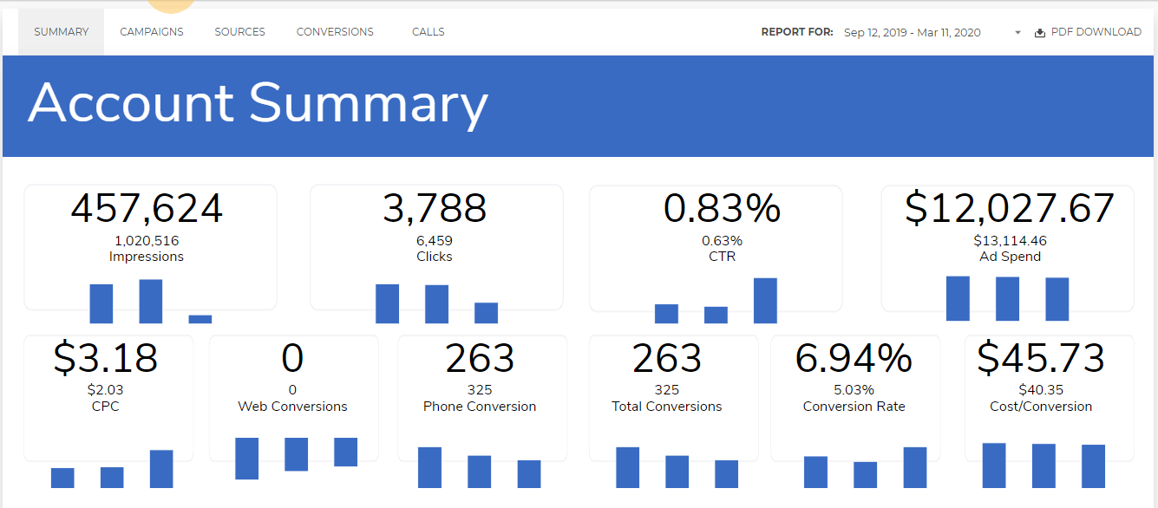
SOCIAL
PROOF
SOCIAL
PROOF

Slide 9
PPC SMART NICHE INSIGHT WITH
THIS INFO:
PPC SMART NICHES
Physical Therapy - General
MINIMUM BUDGET
$750
ESTIMATE SEARCH CPC
$6-10
ESTIMATE CPA RANGE
$35-80
EST LEADS FOR MIN BUDGET
9-21
REMARKETING ELIGIBLE
No/Iffy
RECOMMENDED OFFER
Free or Discount New Patient Consult
LOGO
WHAT YOU NEED TO KNOW
Receptionists may need lead handling training

Slide 10
LET US DO THE SAME FOR YOU

